Slide 1


SMASHY

Slide 2



INDEX
1. | Problem & Solution | 5. | Sustainability
2. | State of the art | 6. | Ethics
3. | Project Management | 7. | Project Development
4. | Marketing | 8. | Conclusion

Slide 3
1. PROBLEM & SOLUTION

Slide 4
PROBLEM & SOLUTION
Problem statement
○ | Pedestrians → most vulnerable road users
○ | Accounting 65% of road crash fatalities
○ | Safety for pedestrians
○ | Jaywalking

Slide 5
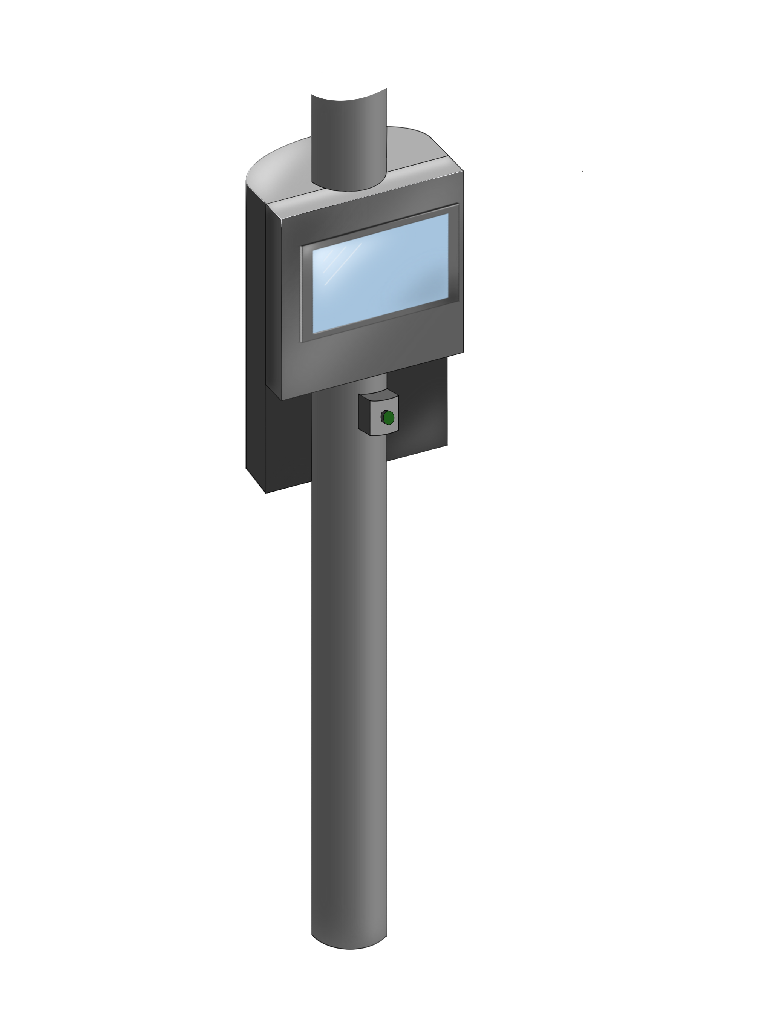
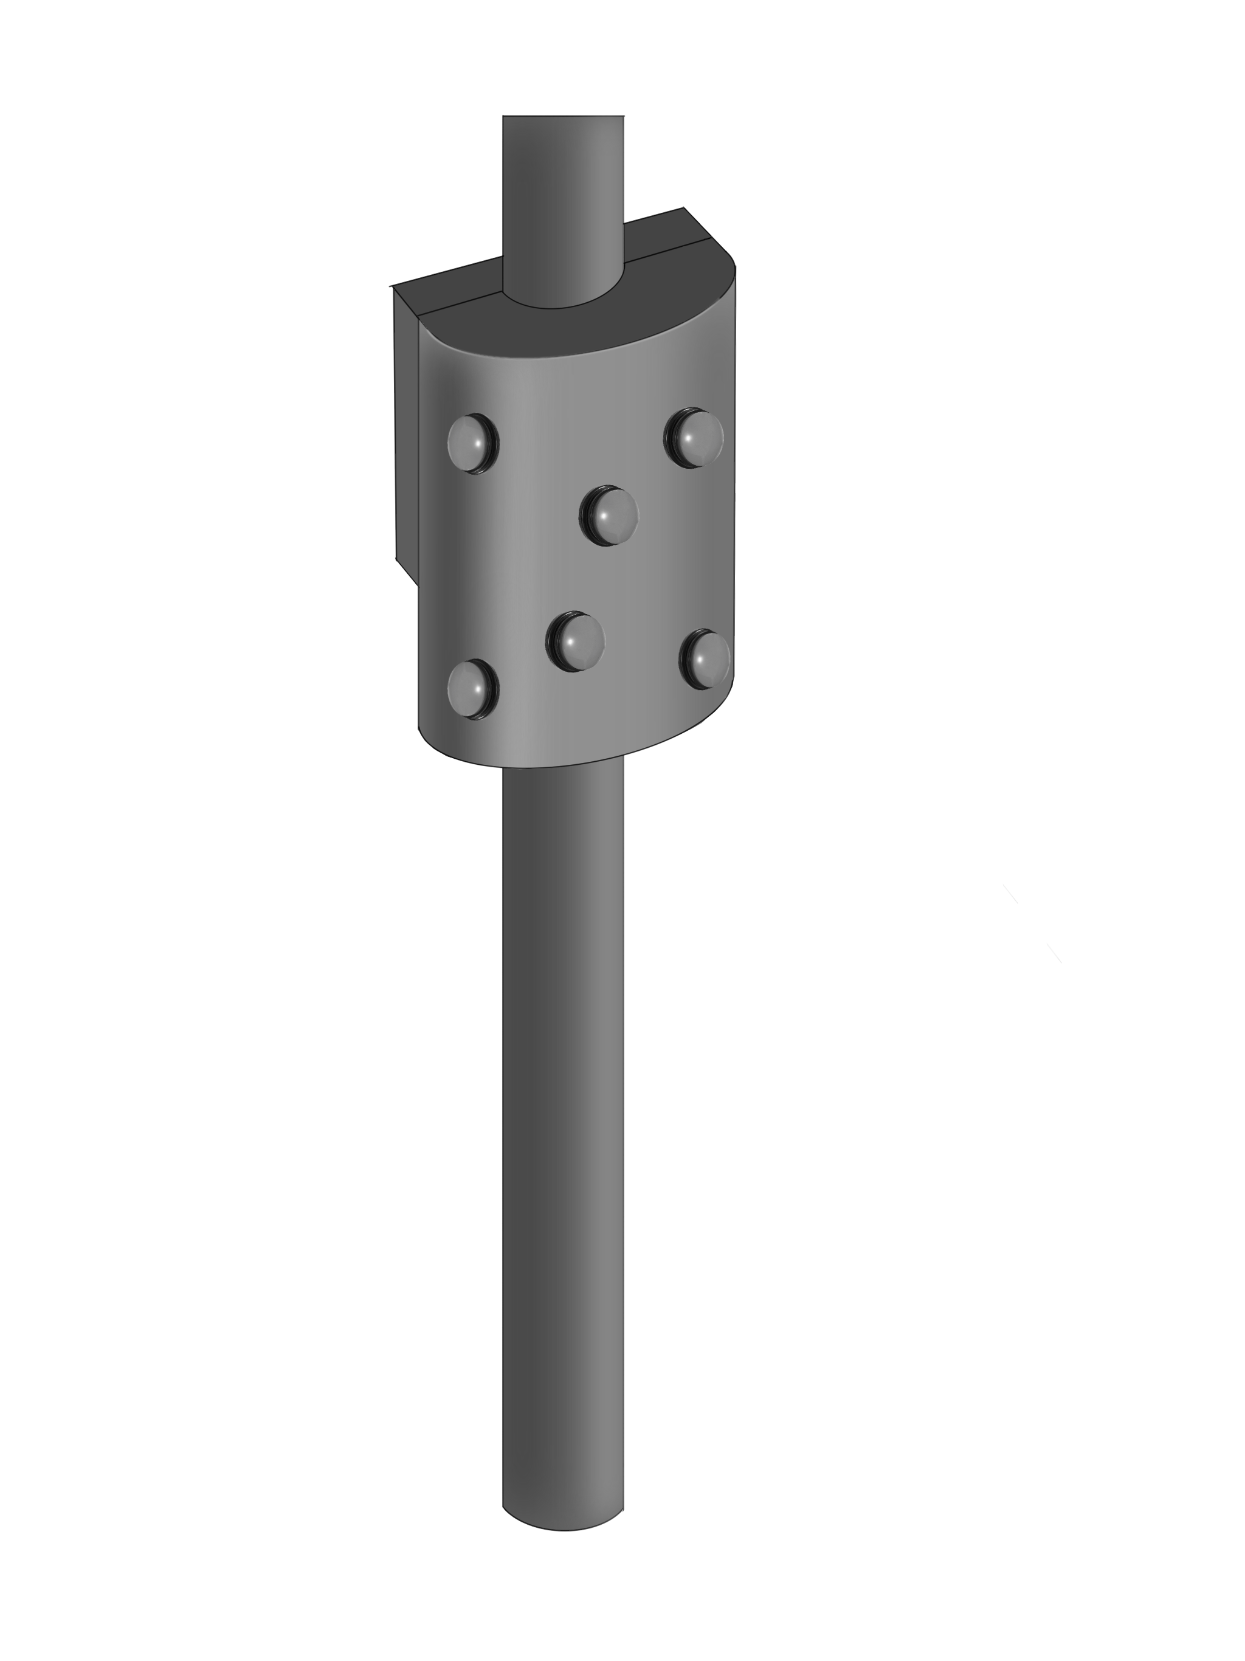
SMASHY
PROBLEM & SOLUTION

Slide 6
PROBLEM & SOLUTION
Solution proposition
○ | Gamification in public
○ | Game module with buttons
○ | Make waiting less boring

Slide 7
INTRODUCTION
WHAT IS

Slide 8
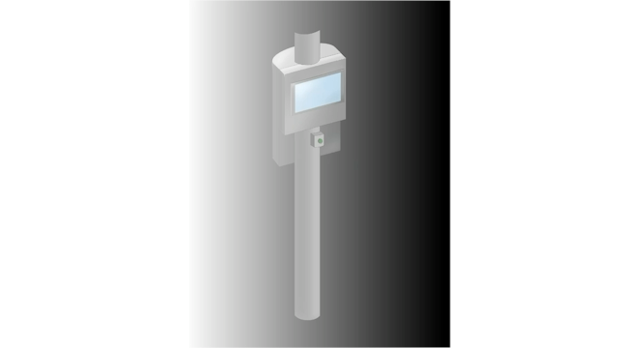
SMASHY
INTRODUCTION
WHAT IS

Slide 9
2. State of the art

Slide 10
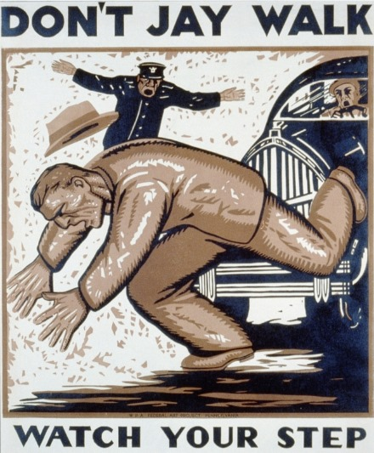
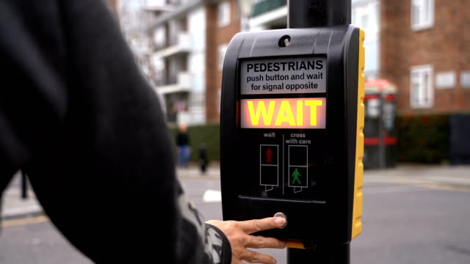
EXISTING JAYWALKING PREVENTION SOLUTIONS
PUBLIC AWARENESS COMPAIN
BUTTON

Slide 11
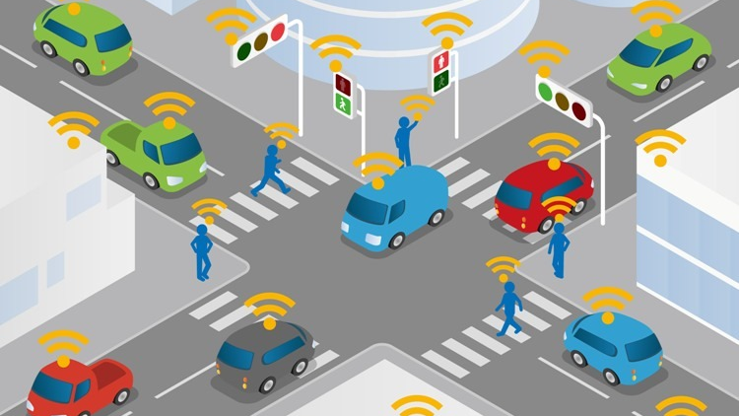
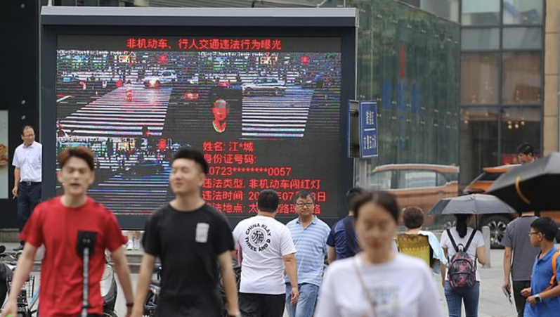
EXISTING JAYWALKING PREVENTION SOLUTIONS
INTELlIGENT TRAFFICLIGHT
InsTALLATION
Facial recognition

Slide 12
STATE OF THE ART
GAMIFICATON
○ | Introduction of game-elements in non game domains
○ | Improves motivation
○ | Enhances participation

Slide 13
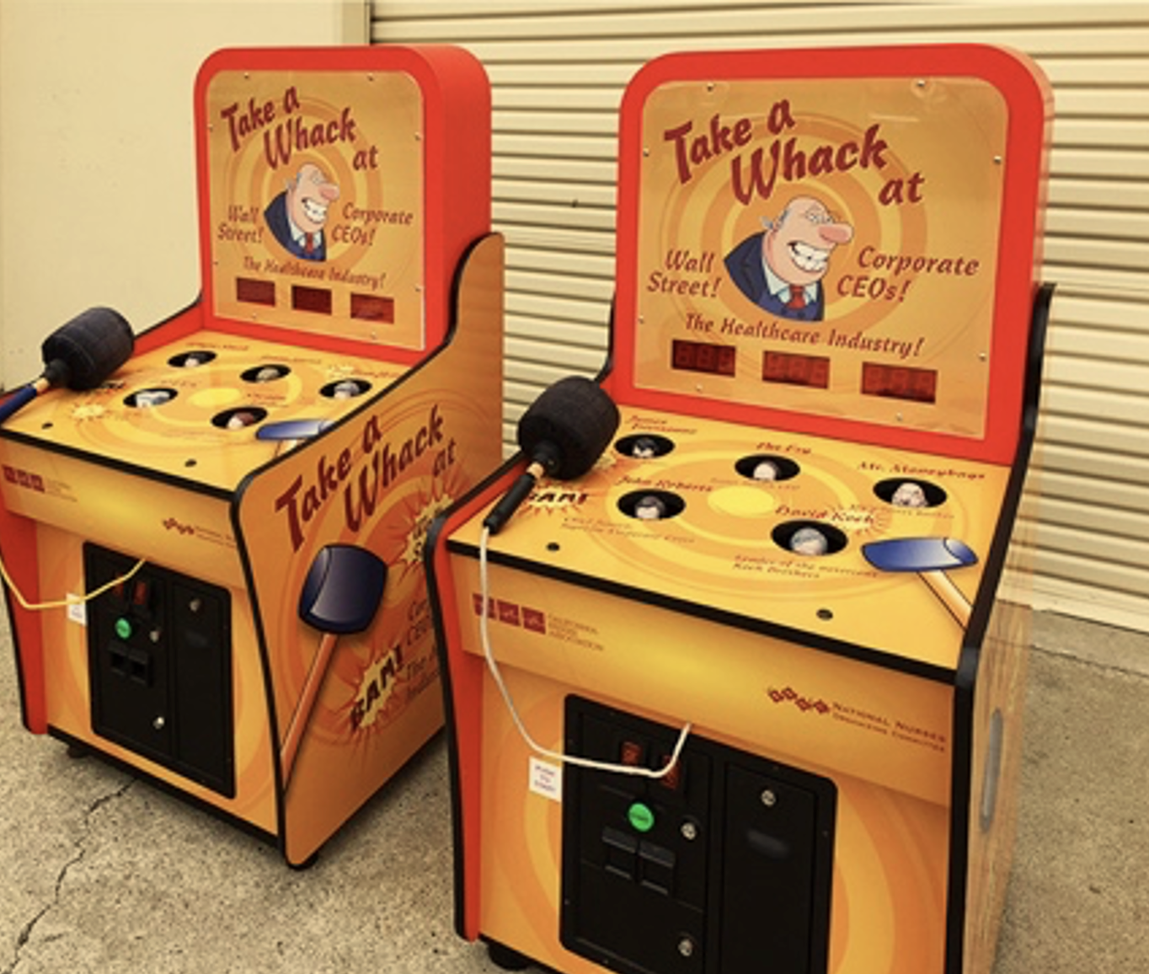
STATE OF THE ART
Advantages OF THE GAME
○ | Occupies both - mind and cognitive faculties
○ | Physical Movement included
○ | Training of reaction time
○ | Alters perception of time

Slide 14
STATE OF THE ART
CONCLUSION
○ | Making game genuinely fun to alter perception of time
○ | Requiring physical movement
○ | Including features like: ✓ Informational Screen ✓ UV-Indicating Paint ✓ Safety Posters

Slide 15
3. PROJEcT MANAGEMENT

Slide 16




SCOPE
TIME
RISK
COMMUNICATION

Slide 17
4. MARKETING

Slide 18
Enviromental
Social
Political
MARKETING
Macro Enviromental Analysis
Technological
Economical
Legal

Slide 19
Suppliers
Customers
Collaborators
MARKETING
MIcro Enviromental Analysis
Intermediaries
Internal Resourses
Competitors

Slide 20
MARKETING
SWOT ANALYSIS

Slide 21
SWOT ANALYSIS
STRENGTHS
○ | Scalability
○ | Customizability
○ | Data collection

Slide 22
SWOT ANALYSIS
WEAKNESSES
○ | Brand recognition
○ | Limited effectiveness

Slide 23
SWOT ANALYSIS
OPPORTUNITIES
○ | Collaboration
○ | Integration

Slide 24
THREATS
SWOT ANALYSIS
○ | Traffic regulations
○ | Public perception

Slide 25
MARKETING
MARKETING STRATEGY

Slide 26
MARKETING STRATEGY
OBJECTIVE
SEGMENTATION
○ | Awareness
○ | Community
○ | Partnerships
○ | Demographic
○ | Psychographic
○ | Geographic
○ | Behavioural

Slide 27
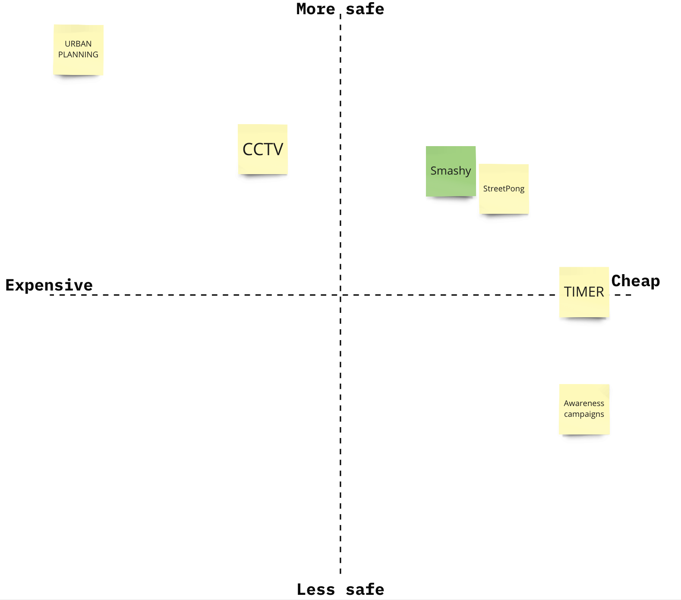
MARKETING STRATEGY
POSITIONING

Slide 28
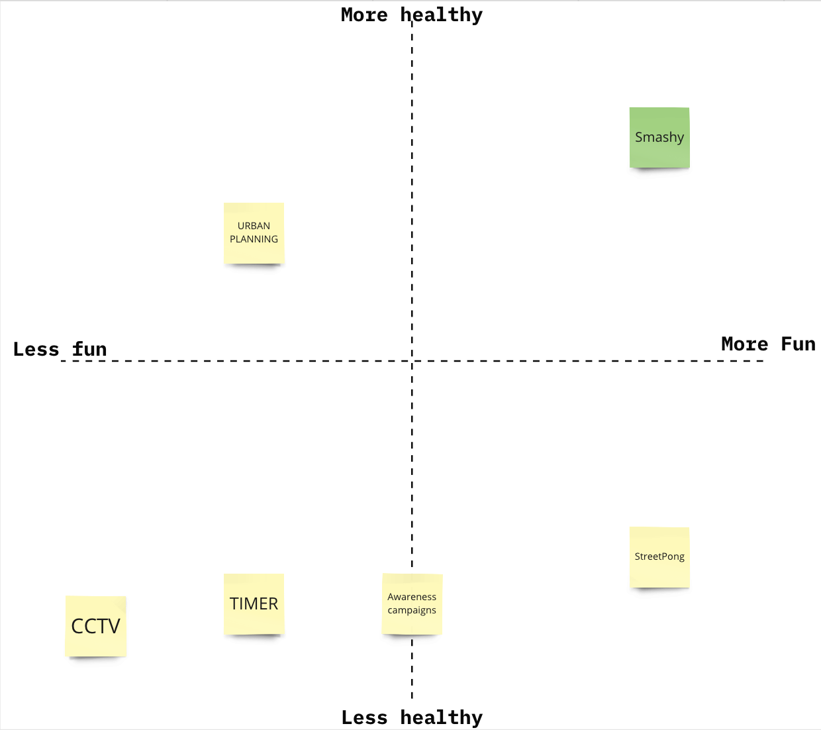
MARKETING STRATEGY
POSITIONING

Slide 29
MARKETING STRATEGY
MARKETING MIX
○ | Product
○ | Price
○ | Place
○ | Promotion
○ | Partnerships

Slide 30
5. SUSTAINABILITY

Slide 31
SUSTAINABILITY
EnVIRONMENTAL
ECONOMICAL
○ | Avoidance of the depletion of natural resources
○ | Long-lasting materials
○ | HDPE & Stainless Steel
○ | Long-term economic growth
○ | No negative impact on social, environmental, and cultural aspects
○ | Cost-effective Product Design
soCIAL
○ | Safety
○ | Fun
○ | Movement and Reaction

Slide 32
6. Ethics & deontology

Slide 33
ETHICS
Engineering
Sales + Marketing
○ | Fundamental cannons
○ | Rules of practice
○ | Moral obligations (safety, health, and well-being)
○ | Customer relationship
○ | Key practices · In-depth knowledge · Customer 1st · Active listening · Competition
Environmental
○ | Relationship with nature
○ | Conscious choices · Materials · Fabrication methods
○ | Carbon footprint

Slide 34
7. PROJECT DEVELOPMENT
Ideation/Concept

Slide 35
PROJECT DEVELOPMENT

Slide 36
LOGO

Slide 37
LOGO

Slide 38
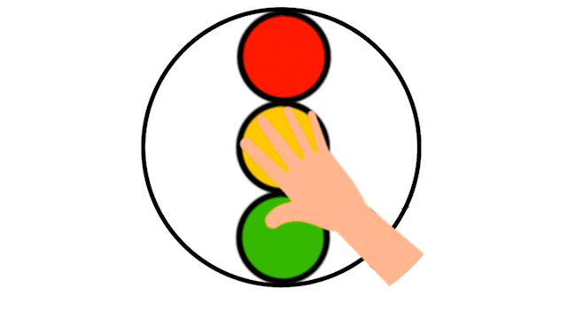

LOGO
EVOLUTION

Slide 39

LOGO
COLOUR

Slide 40
LOGO
SHAPE

Slide 41

LOGO
BLACK

Slide 42
LOGO
WHITE

Slide 43
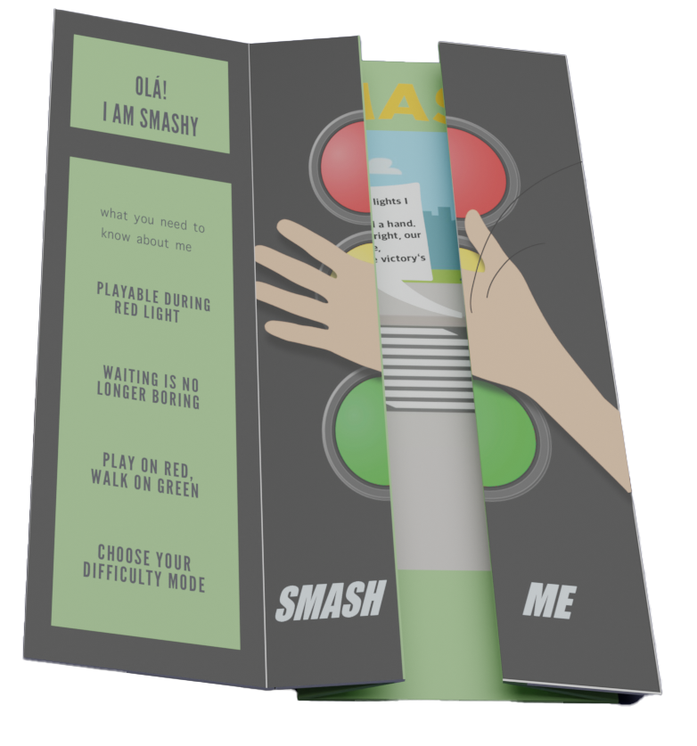
FLYER
CLOSED

Slide 44
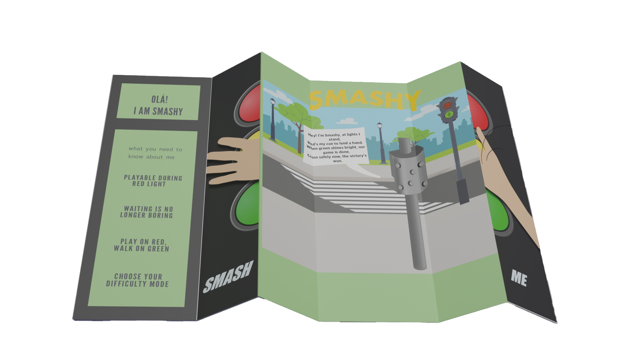
FLYER
OPEN

Slide 45
PROJECT DEVELOPMENT
DESIGN

Slide 46
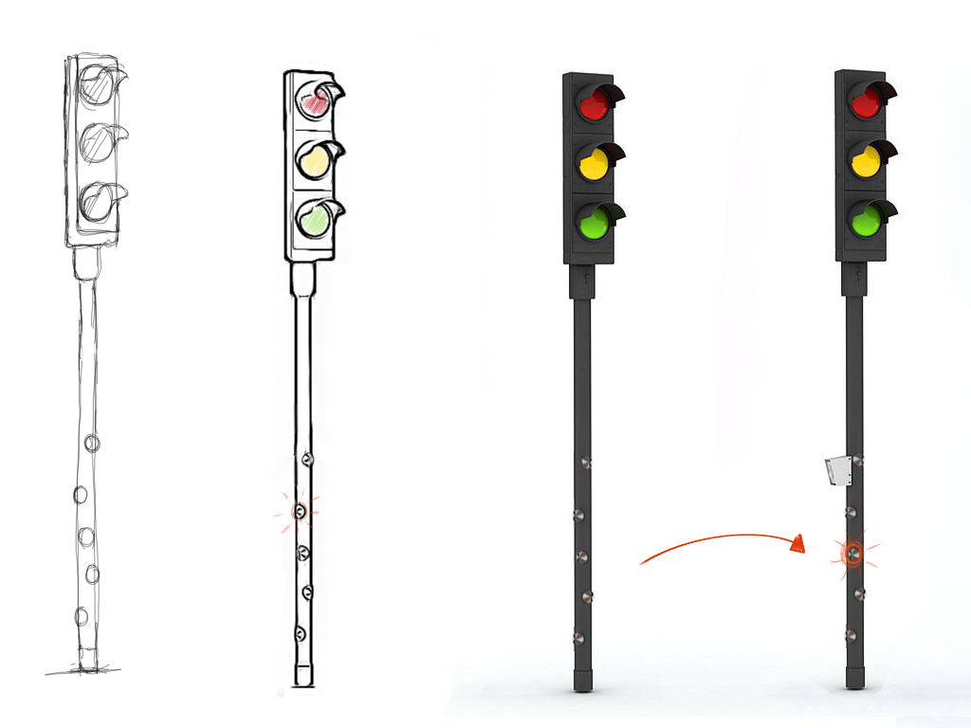
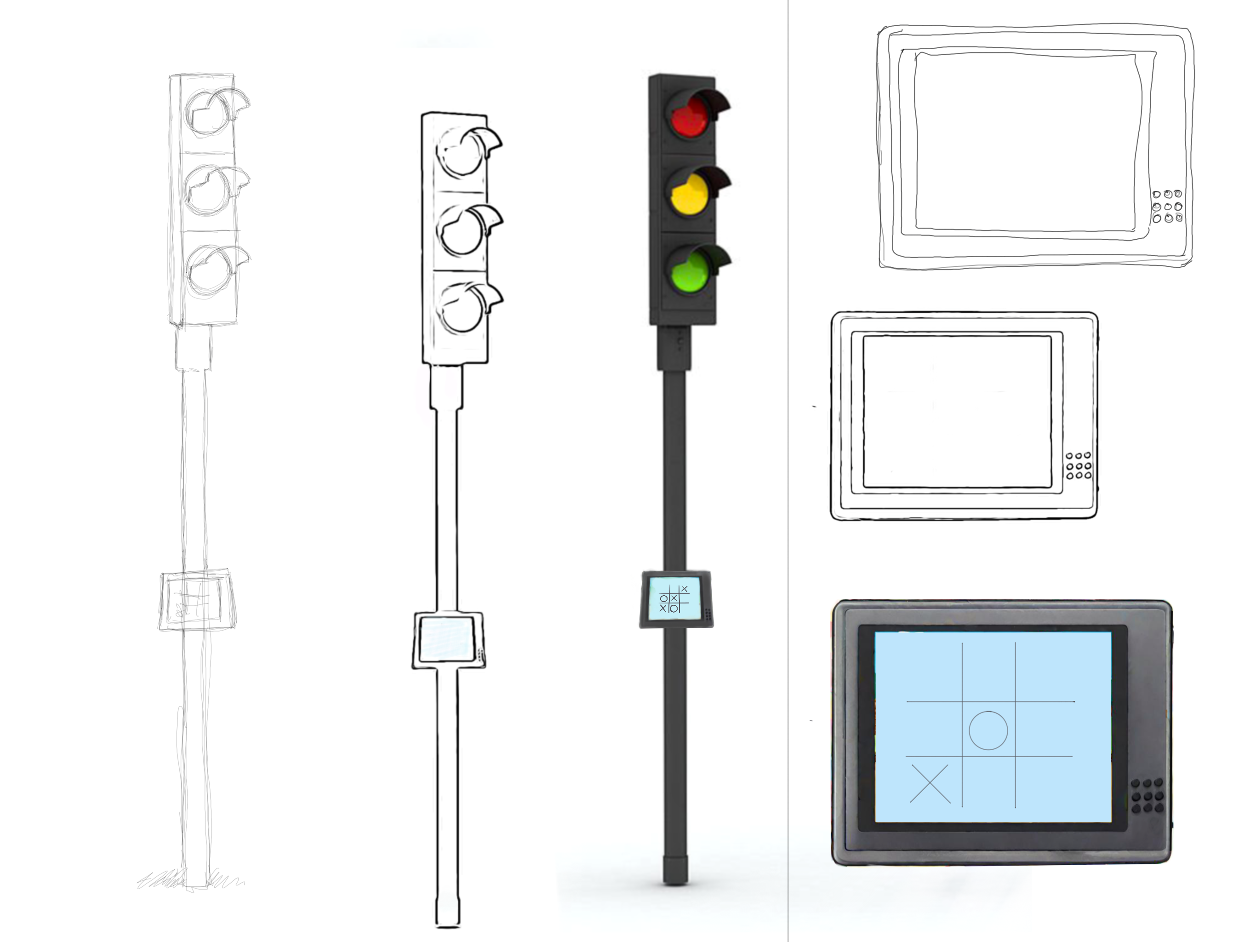
PROJECT DEVELOPMENT
DESIGN 1

Slide 47
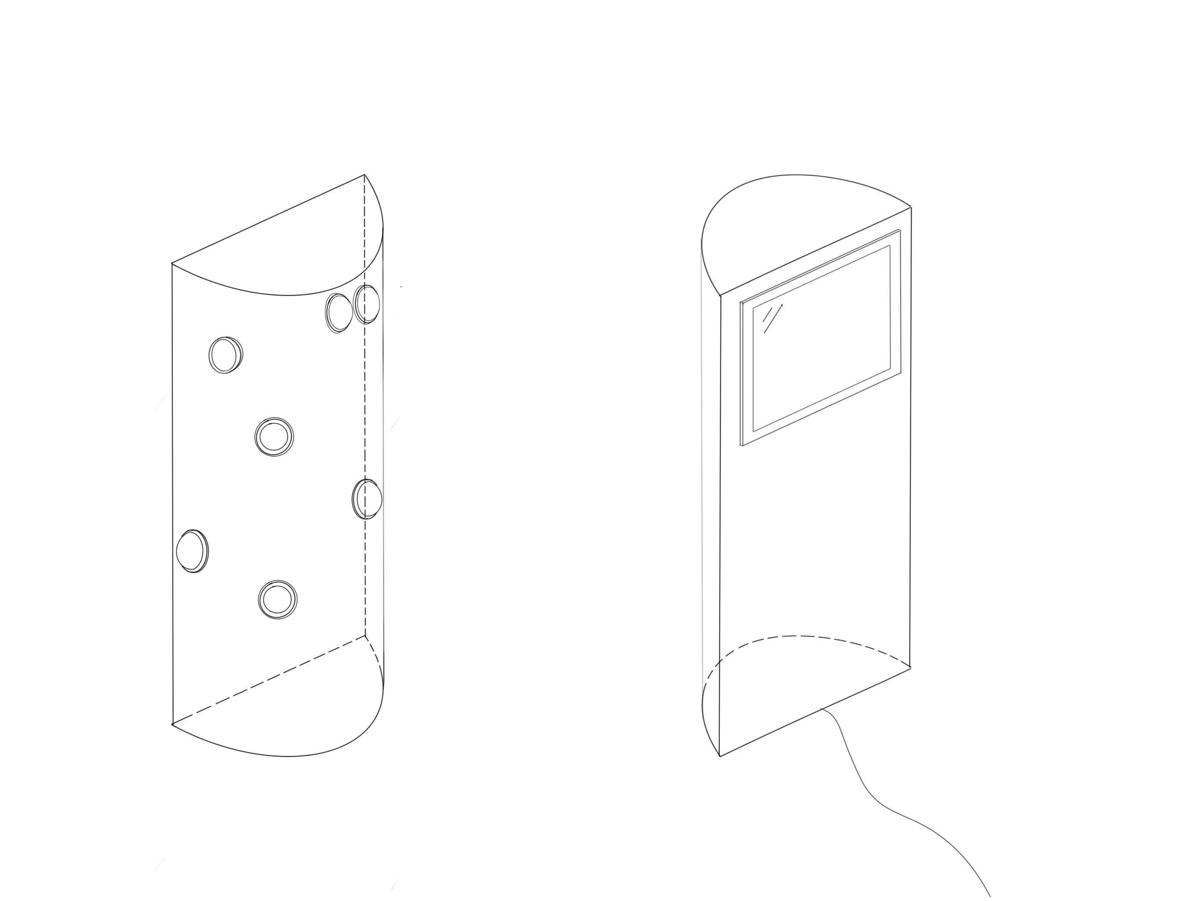
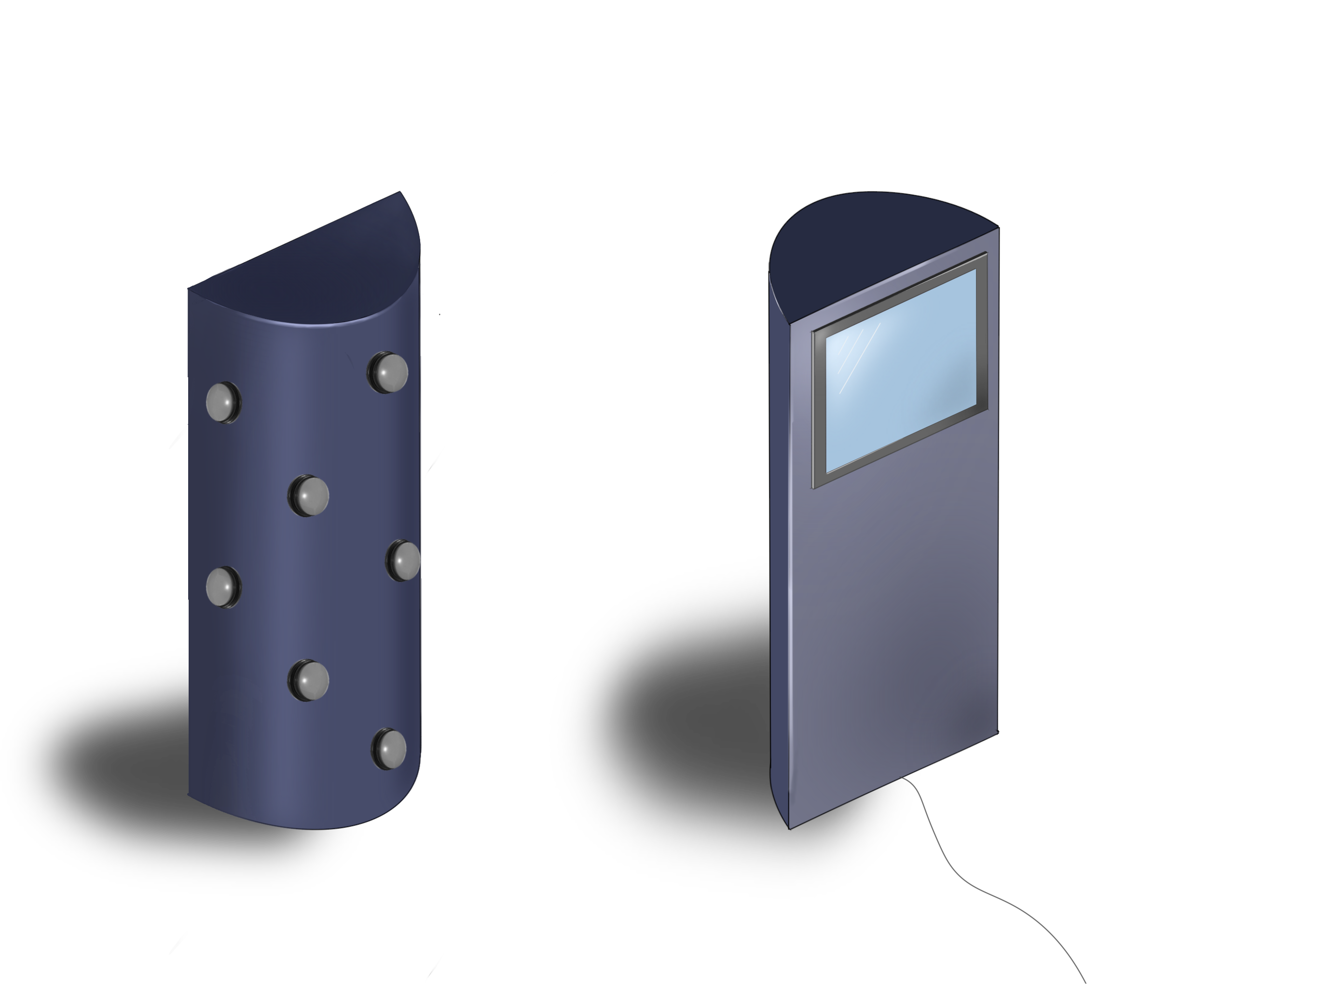
PROJECT DEVELOPMENT
DESIGN 2

Slide 48
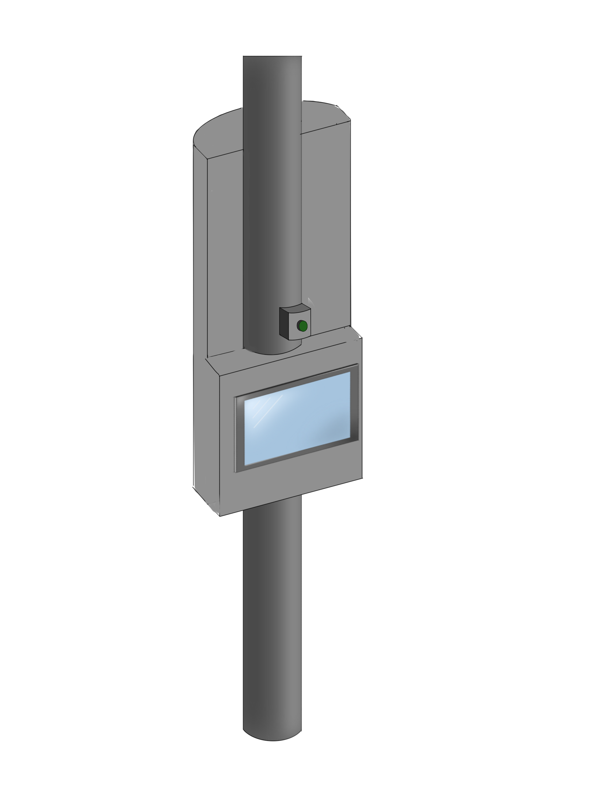
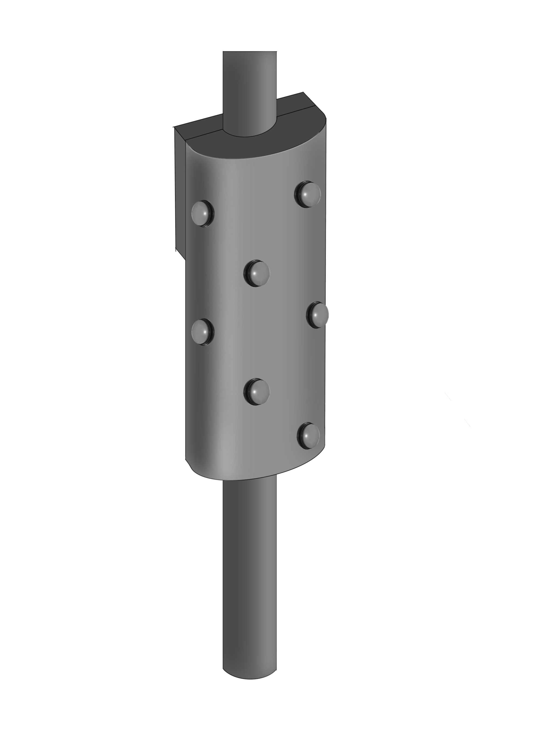
PROJECT DEVELOPMENT
DESIGN 3

Slide 49
PROJECT DEVELOPMENT
DESIGN 4

Slide 50
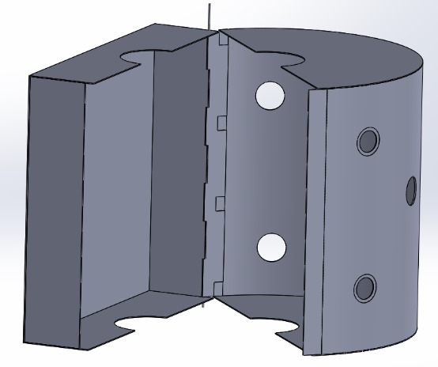
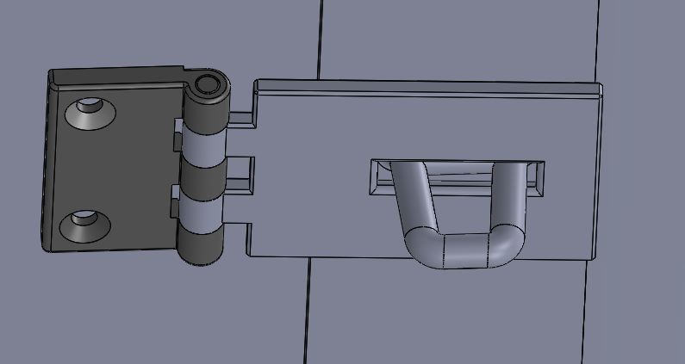
PROJECT DEVELOPMENT
FINAL DESIGN

Slide 51
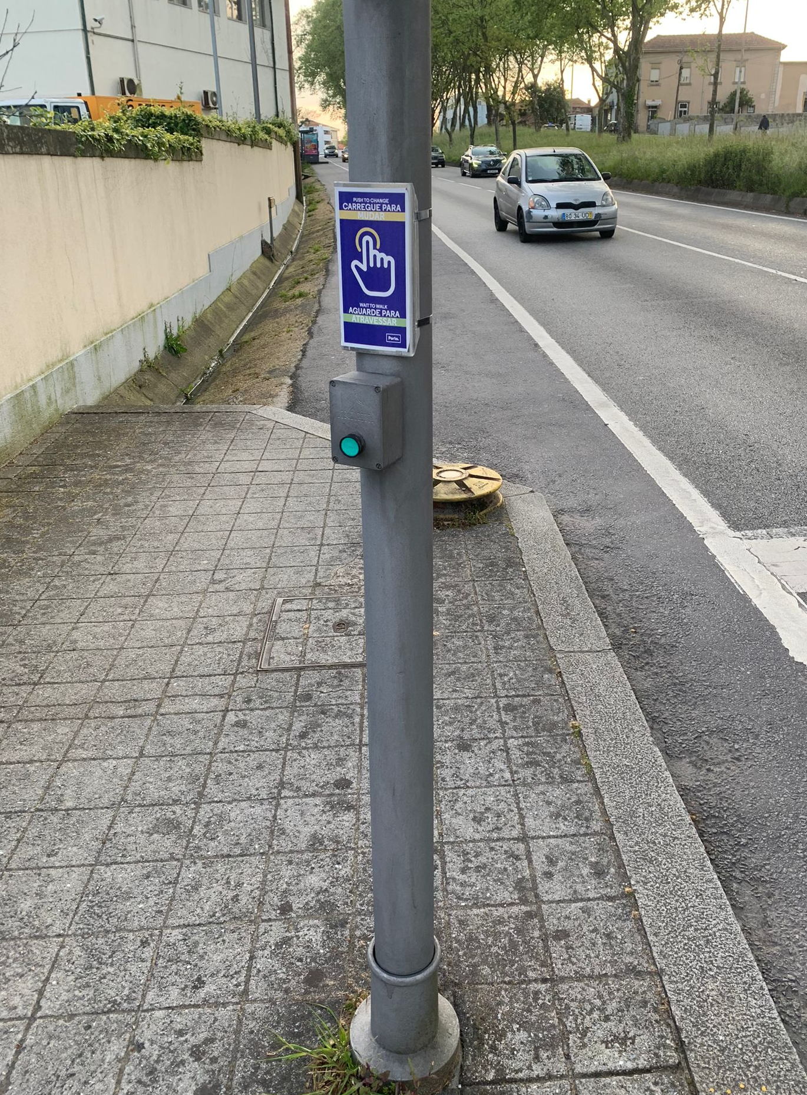
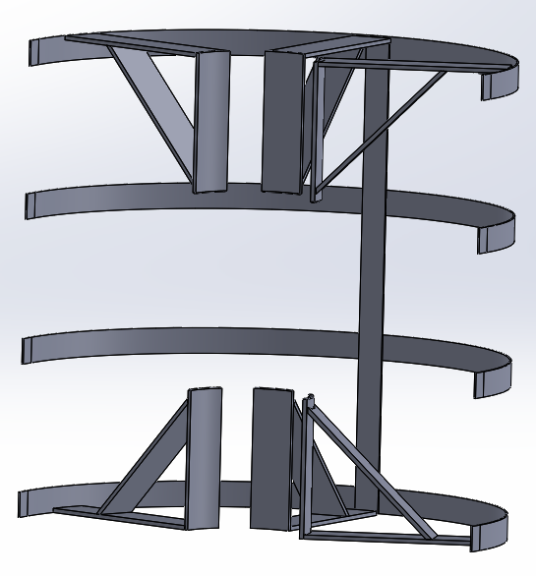
PROJECT DEVELOPMENT
FINAL DESIGN

Slide 52
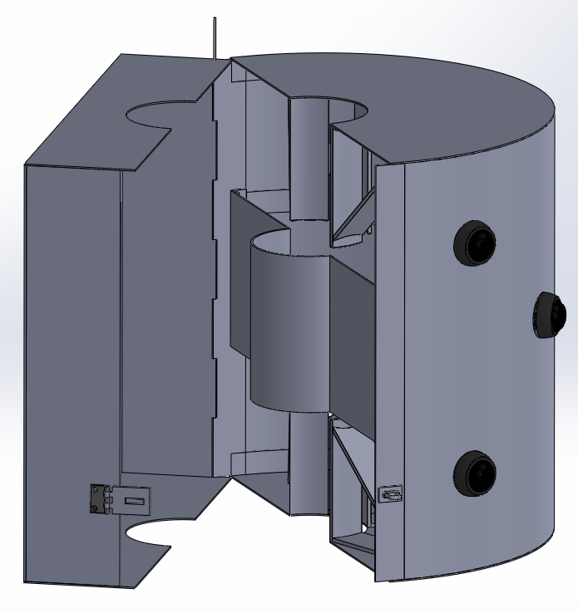
PROJECT DEVELOPMENT
FINAL DESIGN

Slide 53
8. CONCLUSION

Slide 54
8. CONCLUSION
and remember…

Slide 55

8. CONCLUSION
and remember…
STOP
&

